Slide 1


INVICTUS WAREHOUSE DIRECT
CLOSURE OF WAREHOUSE
Team Invictus:
Sai Kiran Baghavathula

Slide 2
TOOLS USED
Database – MySQLWorkBench
Python
GUI – PyQt5
ERD Plus – Entity Relation Diagrams & Relational Schema

Slide 3
OVERVIEW
Acquired dataset from Coursera
Operational Database contains 9 tables warehouses, products, customers, product lines, payments, orders, orderDetails, Employees, Offices
Created Analytical Database containing SalesFact, PaymentsFact, Calender, offices, Customers, Employees, Products

Slide 4
ETL Process
Used Python embedded SQL
Created Operational Database for day to day operations.
Created Analytical database containing dimensional and fact tables and populated data using Operational Database

Slide 5
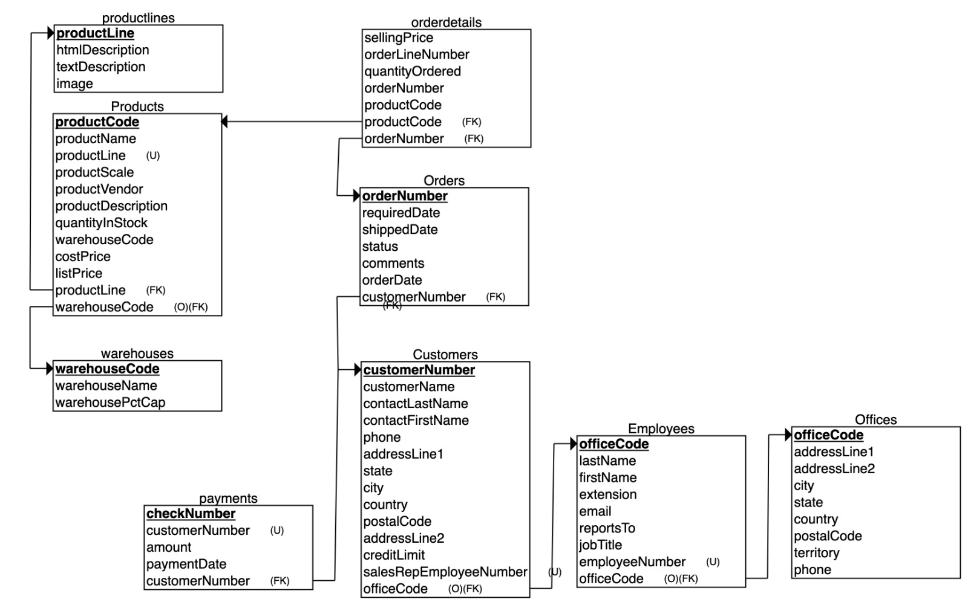
OPERATIONAL DATABASE

Slide 6
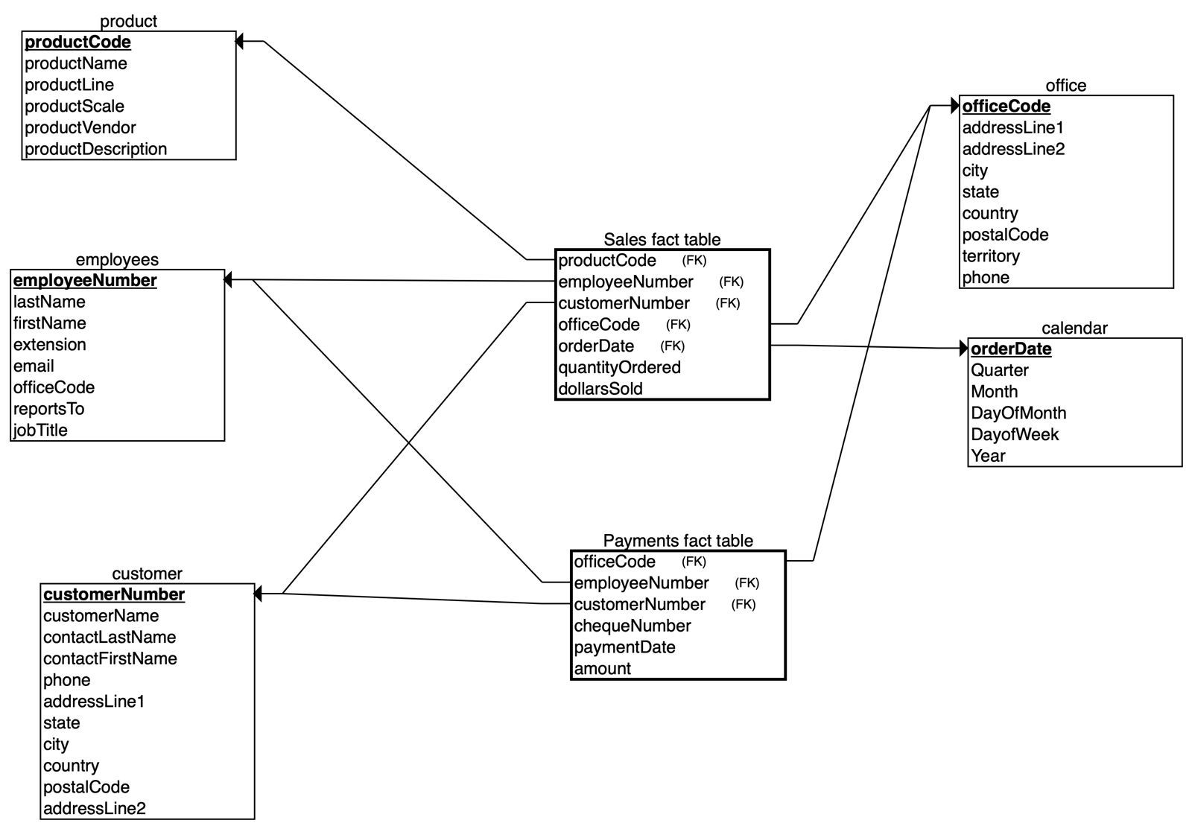
ANALYTICAL DATABASE

Slide 7
GOALS
Determine the warehouse to close in order to uphold the business budget
Identify products to eliminate by examining those with excess inventory and lower sales performance

Slide 8
FINDINGS
There are warehouses with a significant product stock but generate relatively low revenue
Some products have a high stock quantity but low sales

Slide 9
SOLUTIONS
Warehouse that needs to be eliminated is the South warehouse generating less revenue, with products being over stocked.
It can be combined with other warehouse.
We can run flash sale on products, that are over stocked and generating less revenue

Slide 10
THANK YOU

